Slide 1

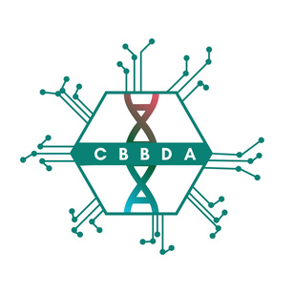
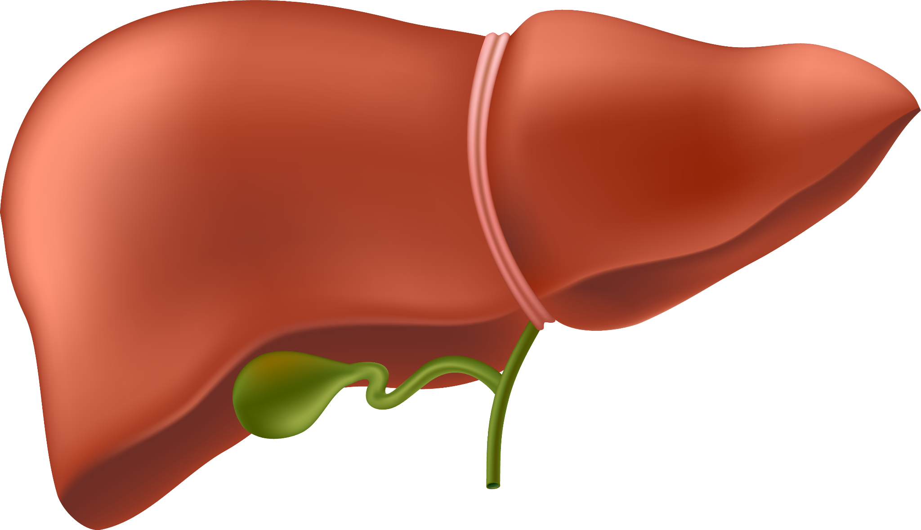
Predictive Modeling of Liver Disorders Using Machine Learning
MASTER OF SCIENCE IN COMPUTATIONAL BIOLOGY, BIOINFORMATICS AND DATA ANALYSIS
Réalisé par : KHAYAR NAJWA
Notes:
Hello everyone, My project is about predicting liver disorders using machine learning.

Slide 2
TABLE OF CONTENTS
01
02
03
04
05
06
Introduction
Dataset Overview
Outlier Detection
Handling Missing Values
08
Conclusion
Machine Learning Models
Dimensionality Reduction
Notes:
We’ll begin with a brief introduction to the importance of the liver and the challenges in early disease detection. Then, I’ll walk you through the dataset used, how I handled missing values, and how I tackled outlier detection.
Next, we’ll explore dimensionality reduction techniques and the machine learning models applied to predict liver disorders. Finally, I’ll summarize the key results and give you the main takeaways in the conclusion.
Let’s get started.

Slide 3
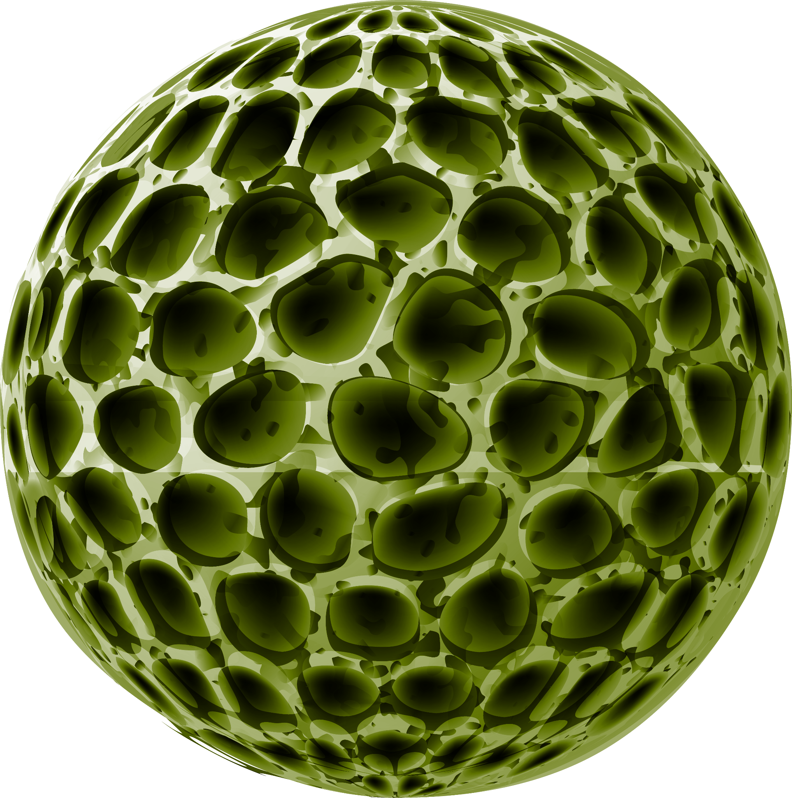
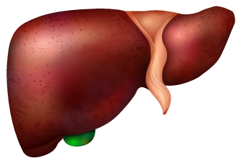
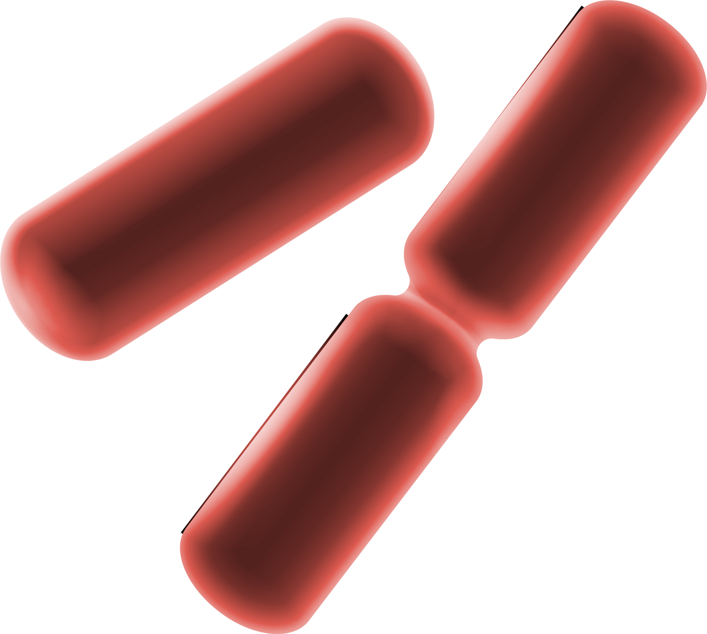
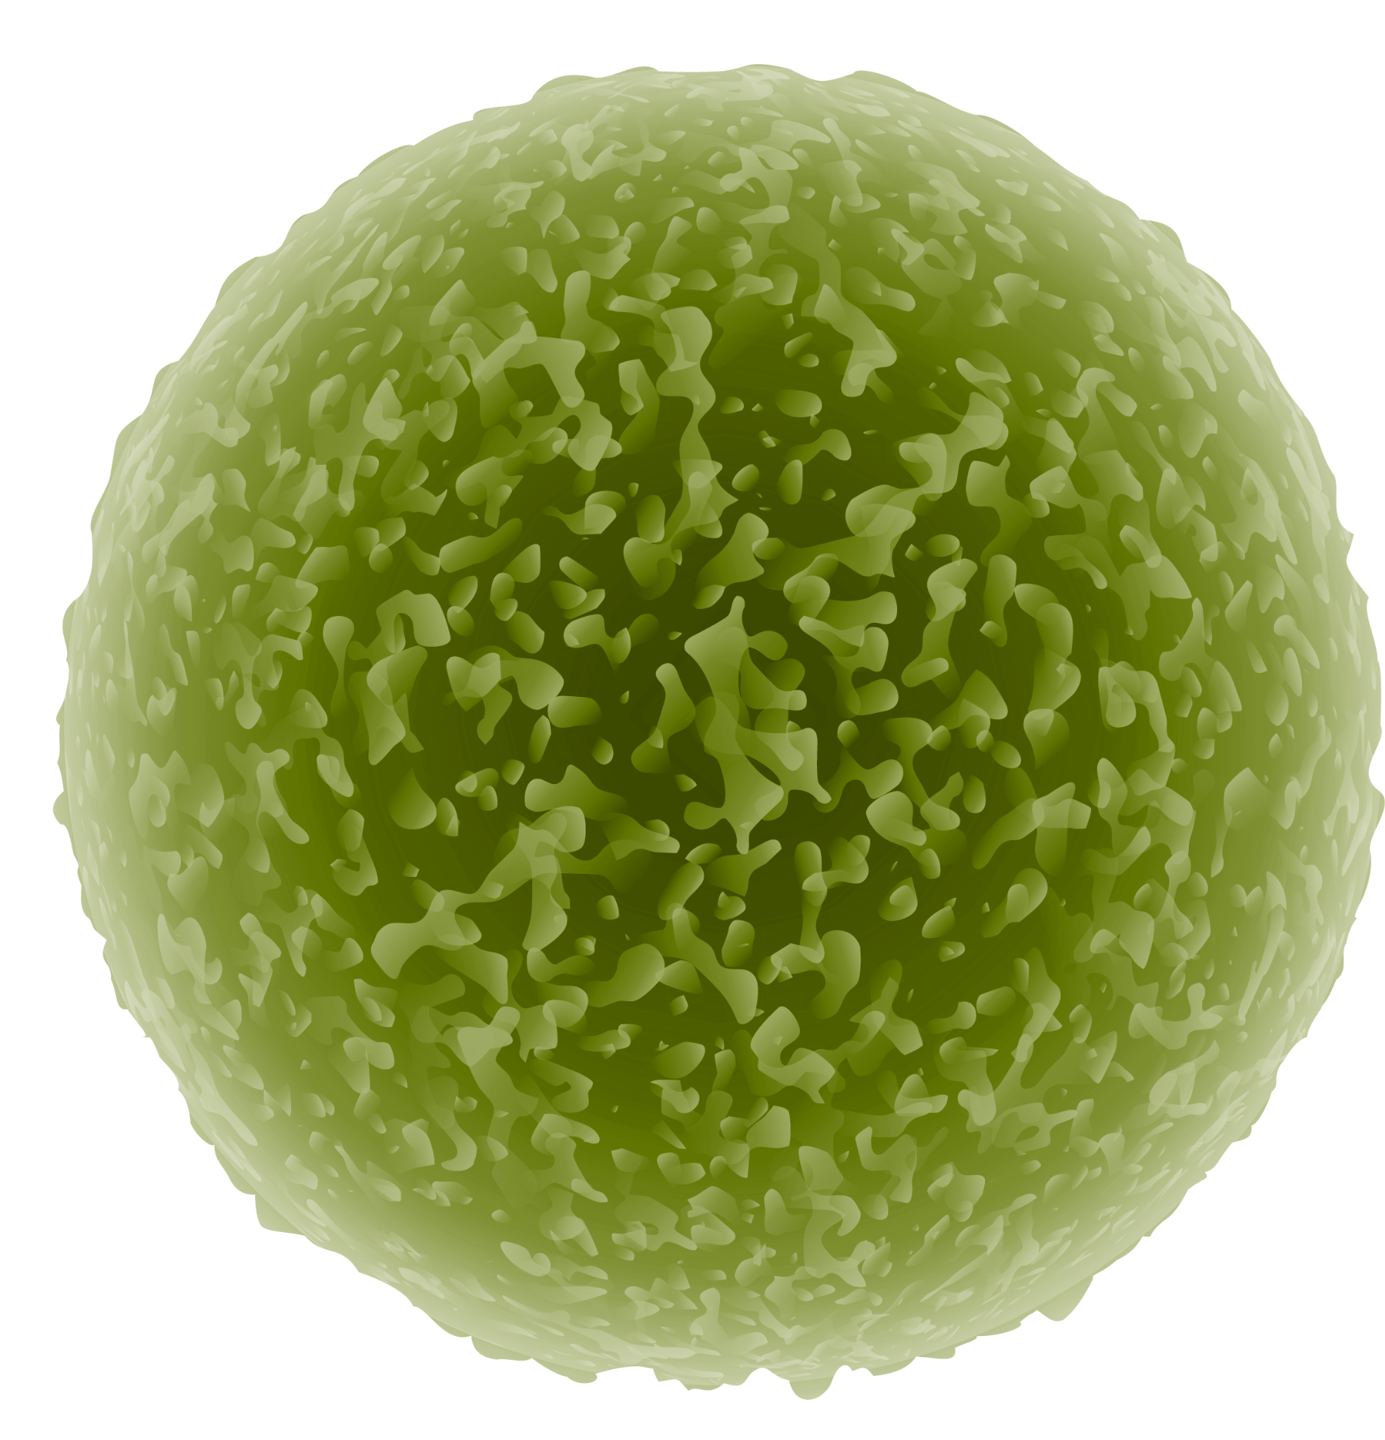
01
Introduction

Slide 4
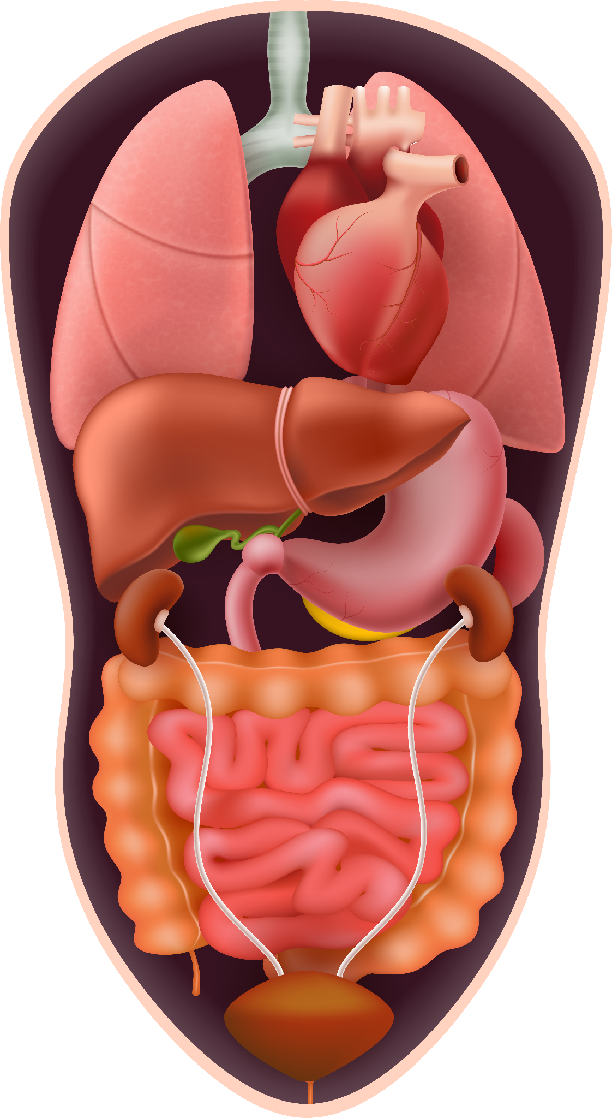
INTRODUCTION
The liver is a vital organ that performs key functions such as metabolism, detoxification, nutrient storage, and bile production.
Liver disorders can be caused by infections (e.g., hepatitis), alcohol abuse, or fat accumulation.
Many liver diseases progress silently, making early detection essential to prevent severe complications like cirrhosis or liver failure.

Slide 5
02
Dataset Overview

Slide 6
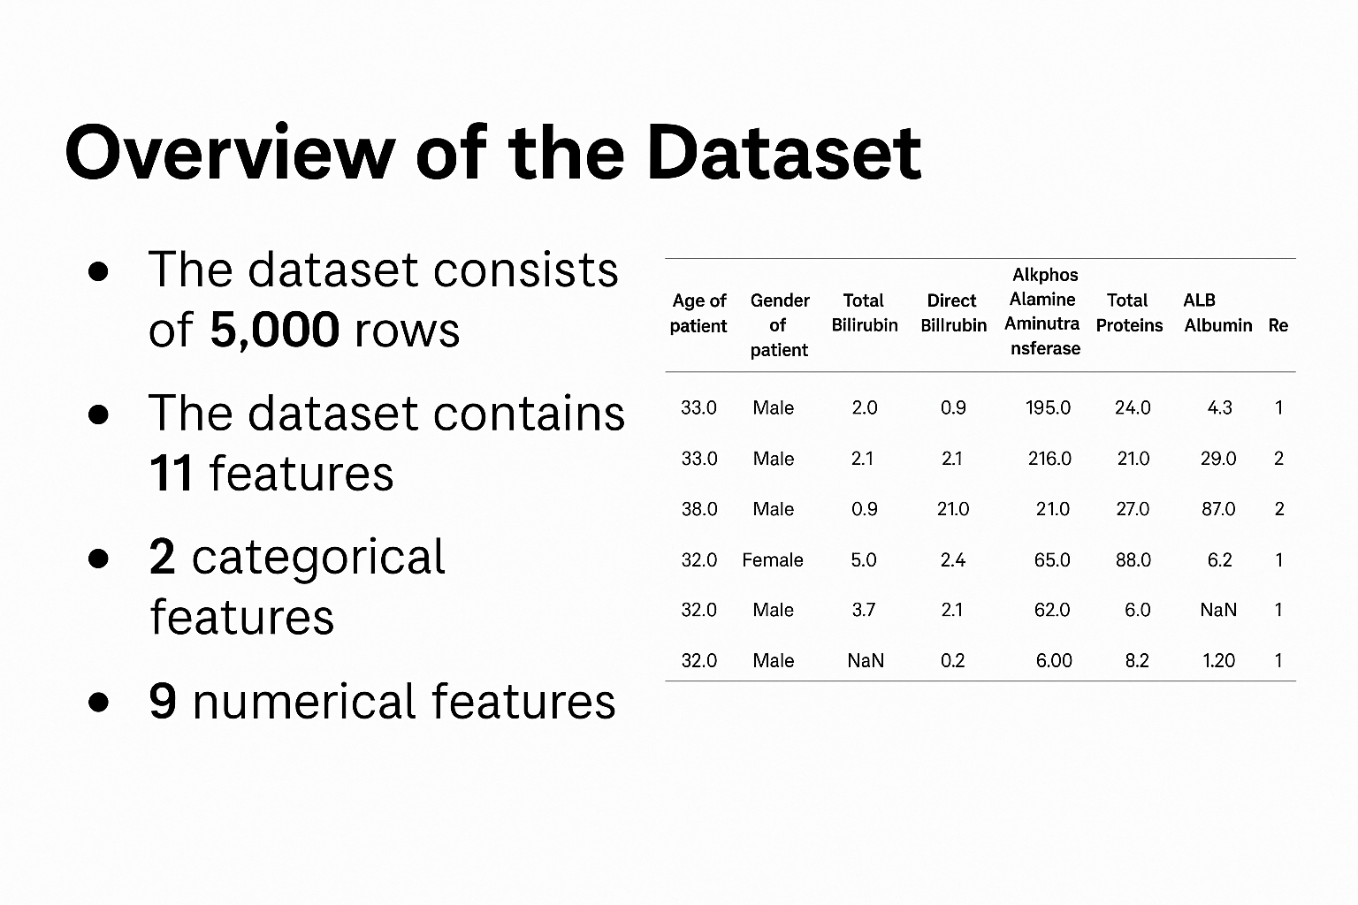
Dataset overview

Slide 7
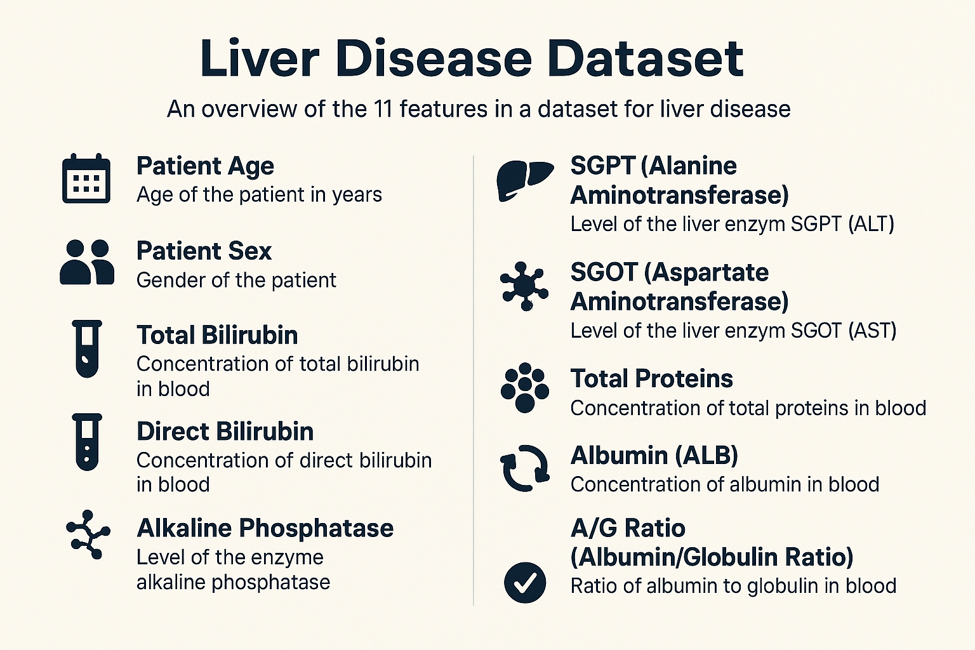
Dataset overview
Notes:
Our dataset includes 11 clinical and biochemical features, such as patient age, gender, bilirubin levels, liver enzyme activity like SGPT and SGOT, protein concentrations, and the albumin-to-globulin ratio.
These variables are important markers of liver health. They help us detect signs of inflammation, cellular damage, or dysfunction.
We used these features as input for our machine learning models to predict whether a patient is healthy or has a liver disorder.

Slide 8
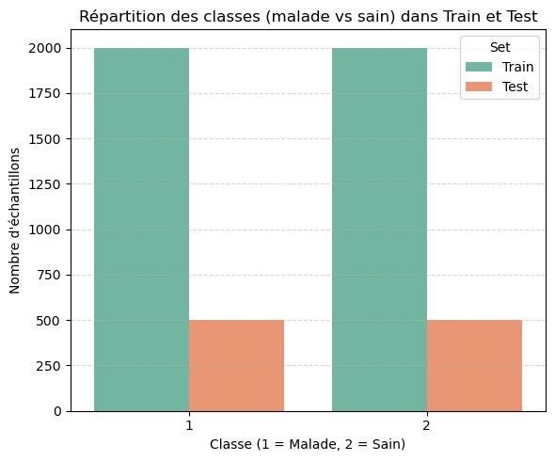
Dataset overview
Notes:
This slide shows the number of patients in each class — sick and healthy — for training and testing.
The classes are well balanced, which helps ensure fair and reliable model learning.”

Slide 9
03
Handling Missing Values

Slide 10
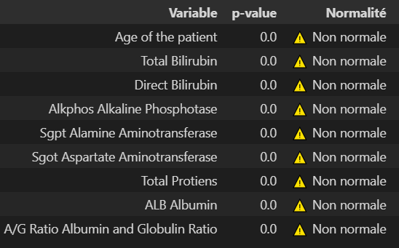
Handling missing values
Normality Testing of Features
Notes:
I tested the distribution of each feature using Shapiro-Wilk. Since all p-values are below 0.05, none of the features follow a normal distribution. So I used models and imputation methods that don’t assume normality.
Since the data is non-normal, I’ll apply non-parametric tests after imputation to check if the distributions remain consistent."

Slide 11
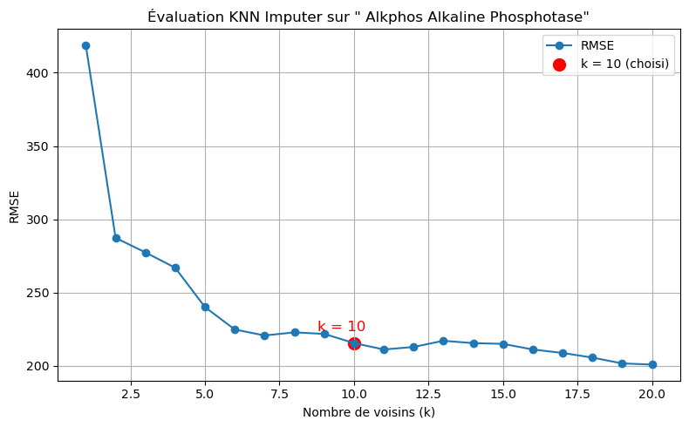
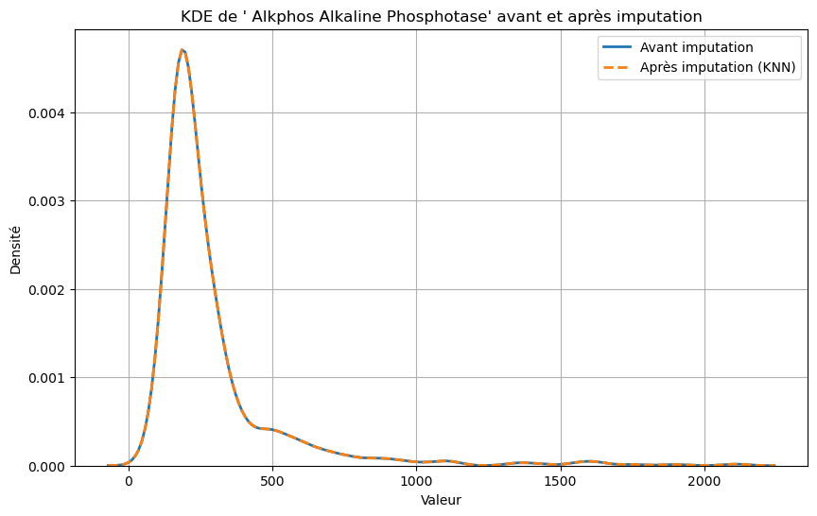
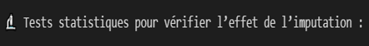
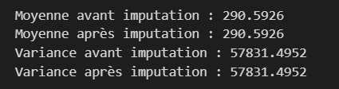
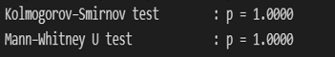
Handling missing values
Alkphos Alkaline Phosphotase
Notes:
For missing values, I used KNN imputation with K = 10, chosen based on the lowest RMSE. To check that this didn’t distort the data, I applied non-parametric tests. Both gave p = 1, meaning the distribution stayed the same. The mean and variance also remained unchanged — so the imputation was stable and reliable.”

Slide 12
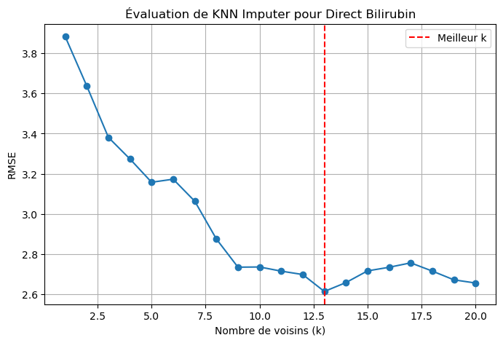
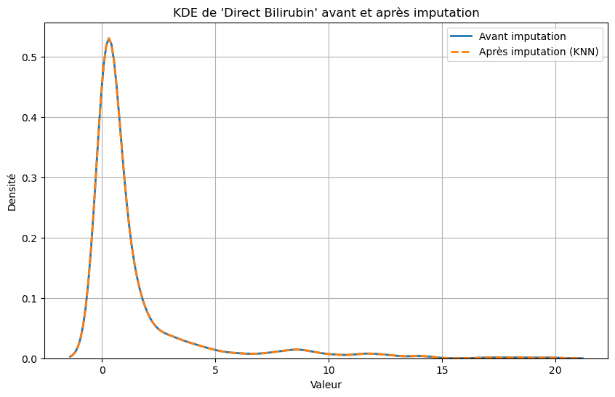
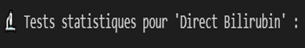
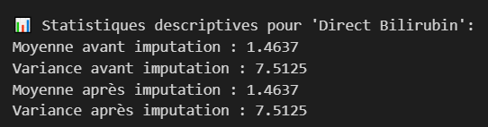
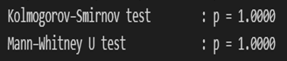
Handling missing values
Direct Bilirubin
Notes:
For Direct Bilirubin, I used KNN imputation with K = 13, selected based on the lowest RMSE. Non-parametric tests gave p = 1, showing the distribution stayed the same. The mean and variance also remained stable — so the imputation was consistent and reliable.

Slide 13
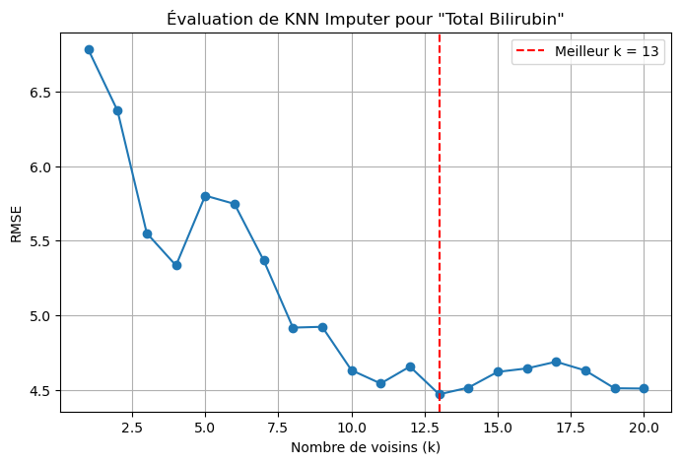
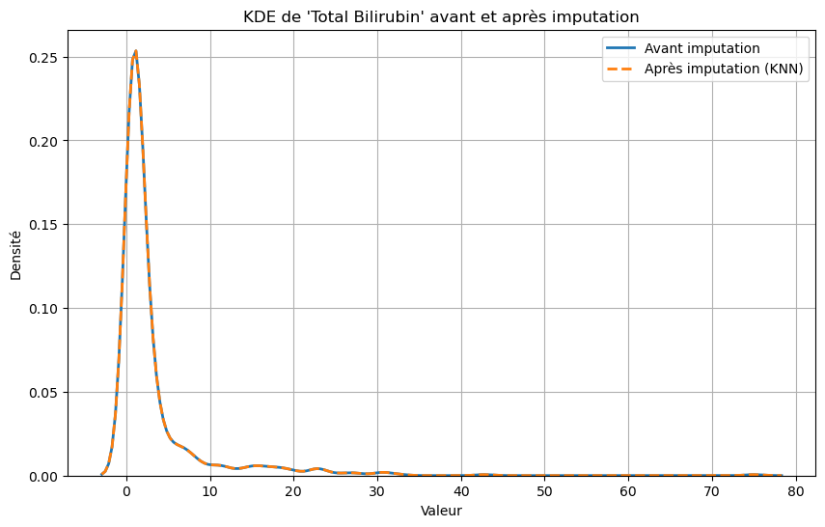
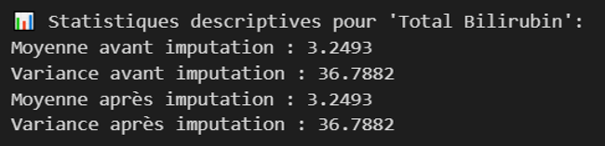
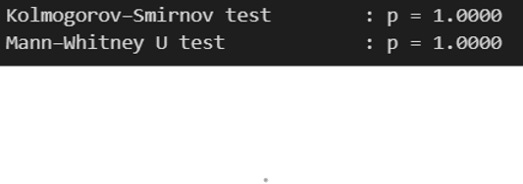
Handling missing values
Total Bilirubin
Notes:
or Total Bilirubin, I used KNN imputation with K = 13, chosen based on the lowest RMSE. To check that the data structure was preserved, I ran non-parametric tests — both gave p = 1, meaning no significant change. The mean and variance also stayed the same, confirming that the imputation was accurate and consistent.

Slide 14
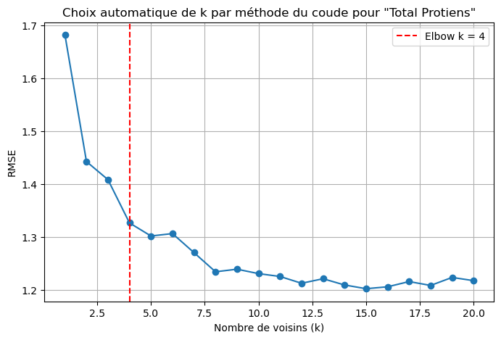
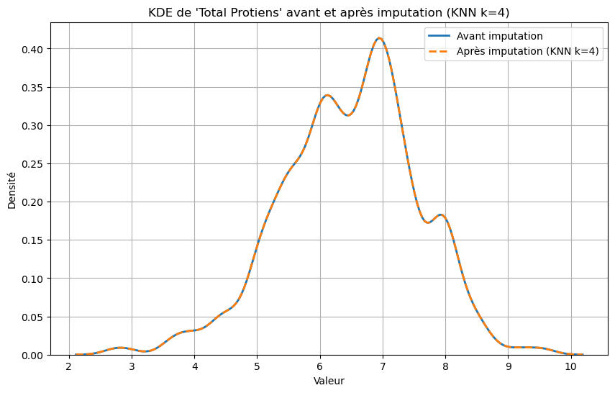
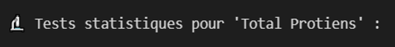
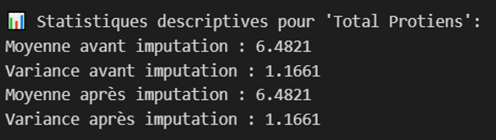
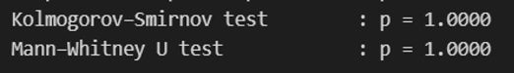
Handling missing values
Total proteins
Notes:
I used KNN imputation with K = 4, chosen using the elbow method based on RMSE. To check consistency, I ran two non-parametric tests — both gave p = 1. The distribution, mean, and variance stayed the same, confirming reliable imputation.

Slide 15
04
Outlier Detection

Slide 16
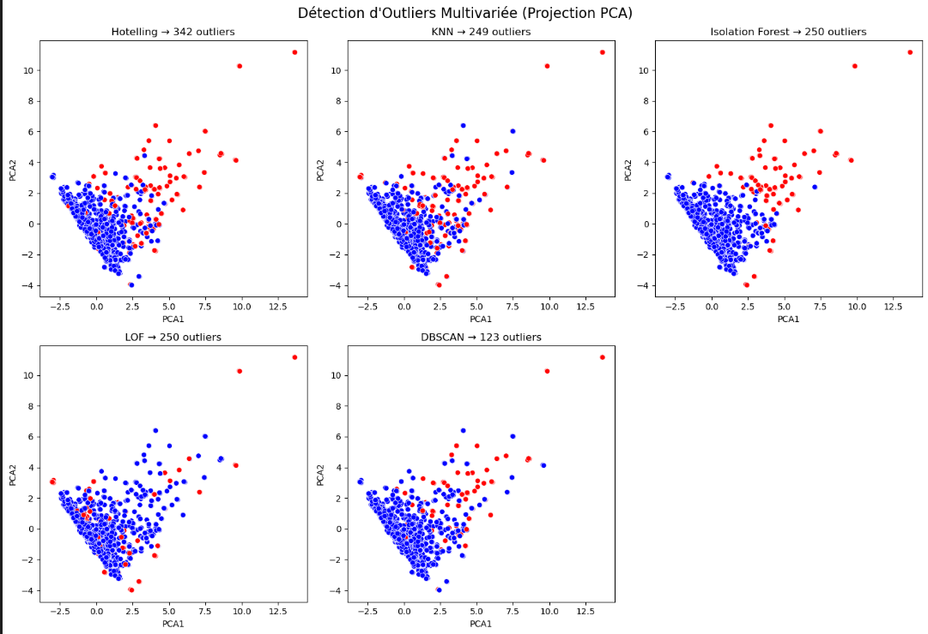
Outlier detection
Notes:
I applied five multivariate outlier detection methods on the PCA-projected data. Hotelling detected the most outliers — 342 — while DBSCAN identified the fewest, 123. The others — KNN, Isolation Forest, and LOF — each found around 250. This comparison helped confirm consistent patterns in identifying extreme values across different techniques.

Slide 17
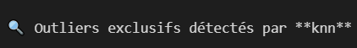
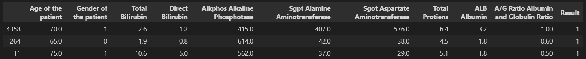
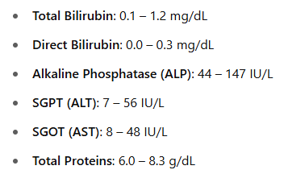
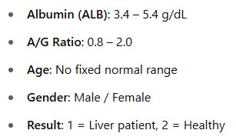
Outlier detection
Notes:
This table shows patient data. Some values are very high or low compared to normal ranges — like high bilirubin or SGPT. That’s why they’re called outliers. They may signal liver problems and help the model learn what to watch for.

Slide 18
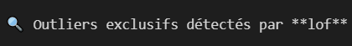
Outlier detection
Notes:
These are sample patient records flagged as outliers. Their values — like bilirubin or liver enzymes — are far outside the normal clinical ranges below. That’s why they were detected as outliers. They may reflect severe liver issues, and help the model recognize rare but important patterns.

Slide 19
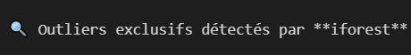
Outlier detection
Notes:
These are outlier patient records. Their values — like extremely high bilirubin or enzyme levels — are far from the normal ranges below. That’s why they were flagged by iForest. They can indicate severe liver problems, and help the model learn to detect rare but important cases

Slide 20
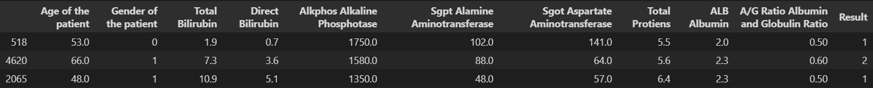
Outlier detection
Notes:
These are outlier patients with values far from normal — like very high bilirubin or enzyme levels. They were flagged by detection methods because such values are rare and may show signs of serious liver issues. Including them helps the model learn how to detect extreme but important cases

Slide 21
05
Dimensionality Reduction

Slide 22
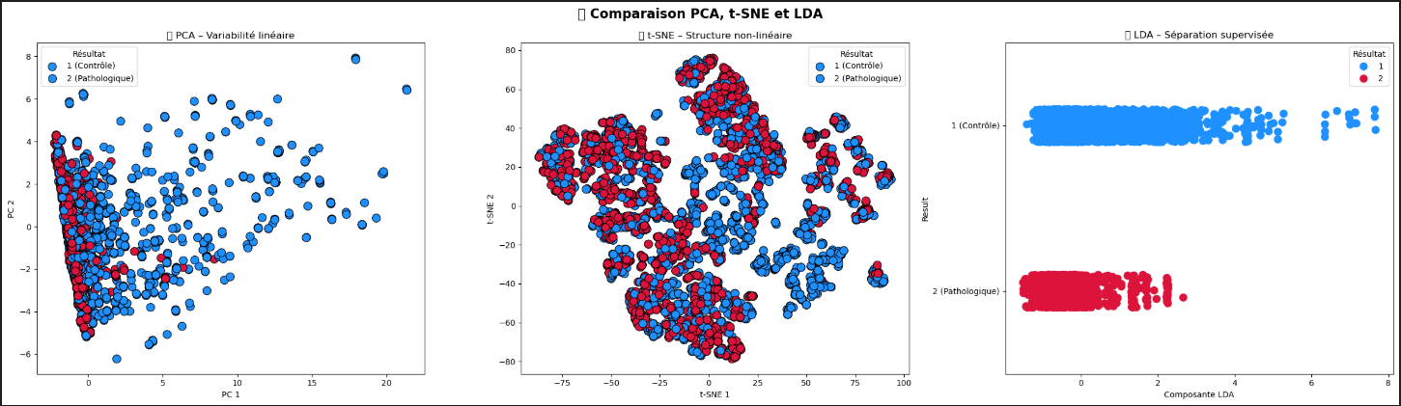
Dimentionality reduction
Notes:
This slide compares three dimensionality reduction methods. PCA shows linear variability but poor separation between the two groups. t-SNE offers better nonlinear separation. LDA gives the clearest split between control and pathological cases, due to its supervised nature. These results helped guide our choice for the next analysis steps

Slide 23
06
Machine Learning Models

Slide 24
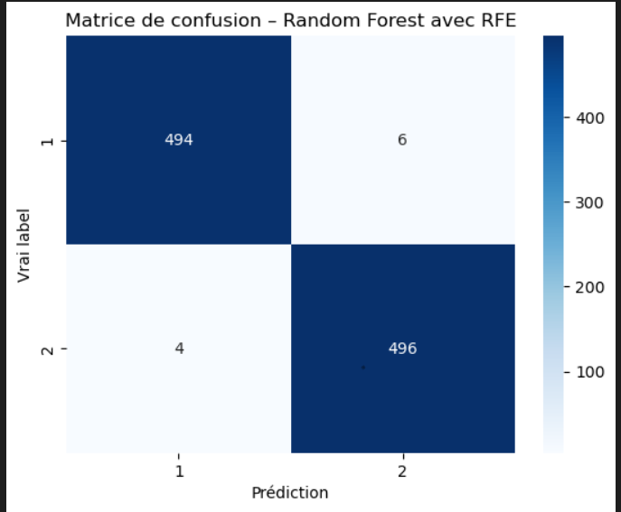
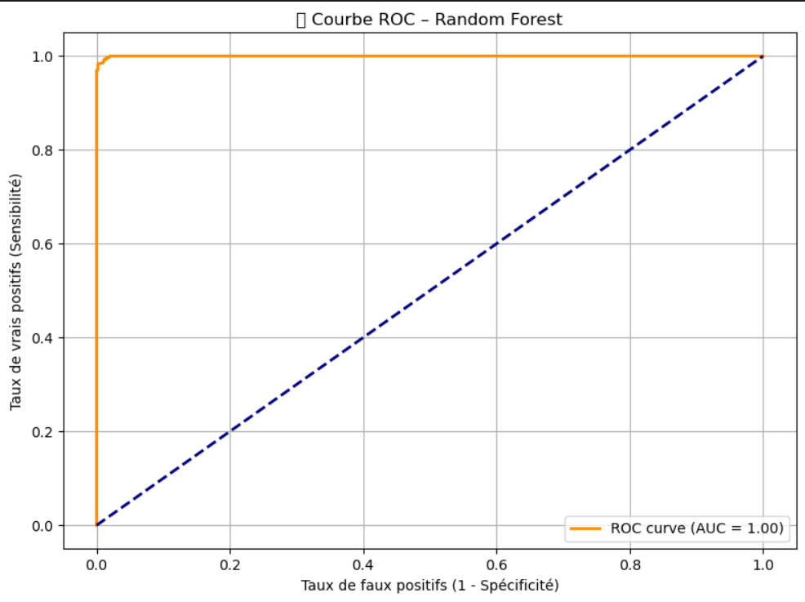
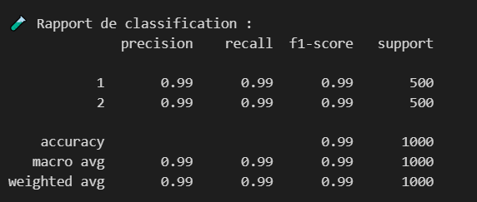
Machine learning model
Random forest
Notes:
This slide shows the performance of our Random Forest model after feature selection using RFE. The confusion matrix shows high accuracy — only 10 misclassifications out of 1,000. The ROC curve has an AUC of 1.00, meaning perfect discrimination. Precision, recall, and F1-score are all 0.99 for both classes — showing strong, balanced performance.

Slide 25
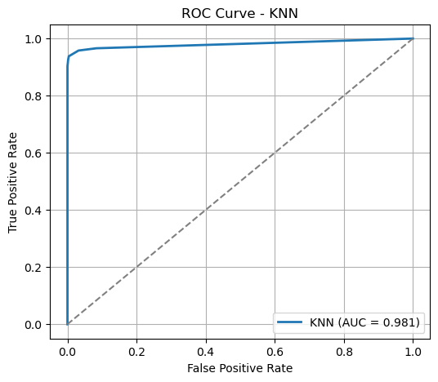
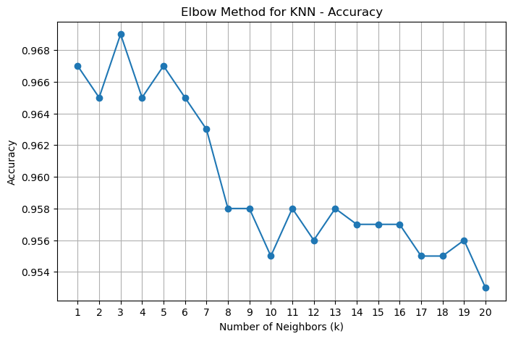
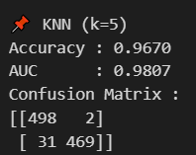
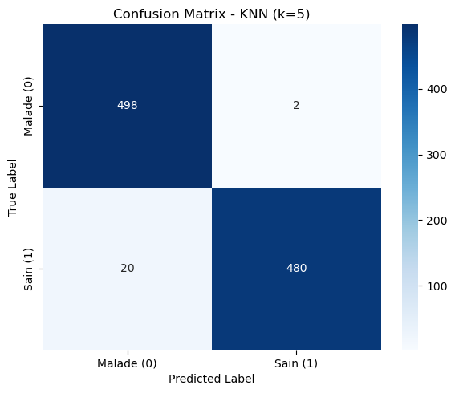
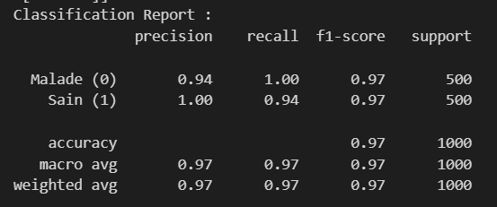
Machine learning model
KNN
Notes:
This slide shows how the KNN model performed. Using the elbow method, I chose K = 5. The model reached 97% accuracy and an AUC of 0.98. The confusion matrix shows very few errors, and the classification report confirms strong and balanced results for both classes.

Slide 26
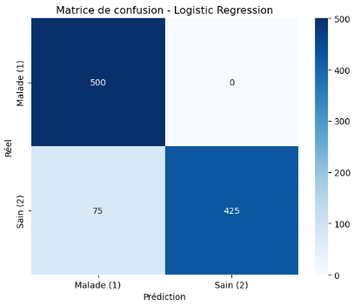
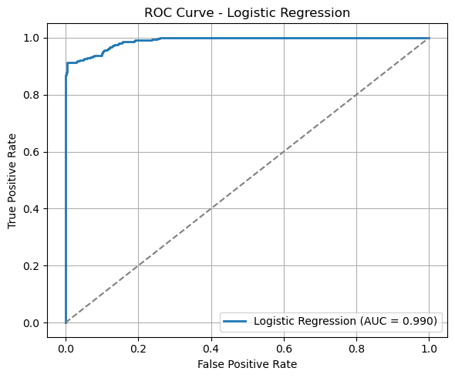
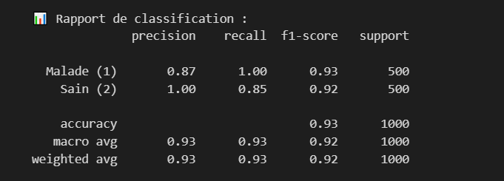
Machine learning model
Logistic regression
Notes:
This slide shows how the Logistic Regression model performed. It achieved 93% accuracy with a perfect AUC of 0.99. The confusion matrix shows strong results for detecting sick patients — no false negatives. Precision and recall are both high, especially for the 'Malade' class, with an F1-score of 0.93. This means the model is reliable and well-balanced.

Slide 27
07
conclusion

Slide 28
Conclusion
This project shows that machine learning can help detect liver diseases early.
Even if PCA and t-SNE don’t clearly separate healthy and sick patients, LDA gave better results by using the class labels.
After selecting the right features, the best model achieved 99% accuracy, which proves that these tools can support clinical decision-making.

Slide 29
THANK YOU FOR YOUR ATTENTION

